Slide 1
LOCAR Writing
Adverse Actions
1st Lt Shepard
A1C George, TSgt Pain
Office of the Staff Judge Advocate

Slide 2
References
DAFI 36-2907, Adverse Administrative Actions, dated 14 October 2022
Privacy Act of 1974

Slide 3
Overview
Who can use counseling, admonishment, and reprimand
What’s the purpose
How to document counseling
Requirements for LOCs/LOAs/LORs

Slide 4
Progressive Discipline
Feedback & Mentoring
Written
Counseling
(LOC, LOA, LOR)
UIF & Control Roster
Demotion
Admin Discharge
Court-Martial
Feedback & Mentoring
Performance Evaluation
Verbal Counseling
Article 15

Slide 5
Purpose of Counseling, Admonition, Reprimand
Used to improve, correct, and instruct subordinates who depart from standards of performance, conduct, bearing, and integrity, on or off duty, and whose actions degrade the individual and unit's mission.
Can be used for offenses committed on and off duty

Slide 6
Who can use LOCAR
General Officers
Commanders
First Sergeants
Supervisors
Other persons in member’s chain of command

Slide 7
Standard of Proof
The standard of proof for adverse administrative actions is the “preponderance of the evidence”
Exists when it is more likely than not that the events alleged have occurred
Determined by evidence and witness’ behavior & knowledge
If such proof is lacking – legally insufficient

Slide 8
Documenting Counseling
Can use AF Form 174, Record of Individual Counseling (RIC)
Plain bond paper
AF Letterhead
Used for positive and negative counseling
Can be filed in UIF

Slide 9
The Privacy Act of 1974
LOCs, LOAs, LORs are subject to rules of access, protection, and disclosure outlined in the Privacy Act of 1974

Slide 10
Record of Individual Counseling, AF Form 174 (RIC)
Used to record a verbal counseling or as a written counseling
Can be positive or negative
Least severe form of written administrative action
Optional Filing in UIF for Officers and Enlisted

Slide 11
AF Form 174

Slide 12
Letters of Counseling (LOCs)
Administrative censure (expression of disapproval) for violation of standards
Used for correcting habits or shortcomings not criminal or illegal
Help Airmen use good judgement, assume responsibility, understand and maintain standards, and face and solve problems
Optional Filing in UIF for Officers and Enlisted

Slide 13
Letters of Admonishment (LOAs)
More severe than RIC/LOC
Used to document a first offense or address behaviors not corrected through counseling
Optional Filing in UIF for Officers and Enlisted
Officers: If not UIF – Must file in PIF

Slide 14
Letters of Reprimand (LORs)
More severe than a counseling or admonishment
Indicates stronger degree of official censure (expression of disapproval)
Used when other methods have failed to correct behavior
Optional filing in UIF for Enlisted, mandatory for Officers

Slide 15
How to Write LOC/A/R
PARAGRAPH ONE
On [DATE] you [FACTS]
Discuss the events that occurred
MUST include evidence for each allegation in attachments
May cite UCMJ
PARAGRAPH TWO
You are hereby REPRIMANDED!
Discuss the impact of what the member did or failed to do
Discuss what improvement is expected
Last sentence: You conduct is unacceptable and any further deviation may result in more sever action
PARAGRAPH THREE
STANDARD TEXT

Slide 16
Requirements for written LOCs, LOAs, LORs, cont’d
Attachments (redact PA & PII)
Relevant statements/MFRs
Portions of investigations (Release Authorization is required)
Reports, logs, etc
Other documents that serve, in part or in whole, as the basis for the letter

Slide 17
INDORSEMENTS
Must include proper four indorsements outlined in DAFI 36-2907
DO NOT USE LOCAR GENERATORS ONLINE!
*Legal office provides LOCAR template*

Slide 18
TIP SHEET

Slide 19
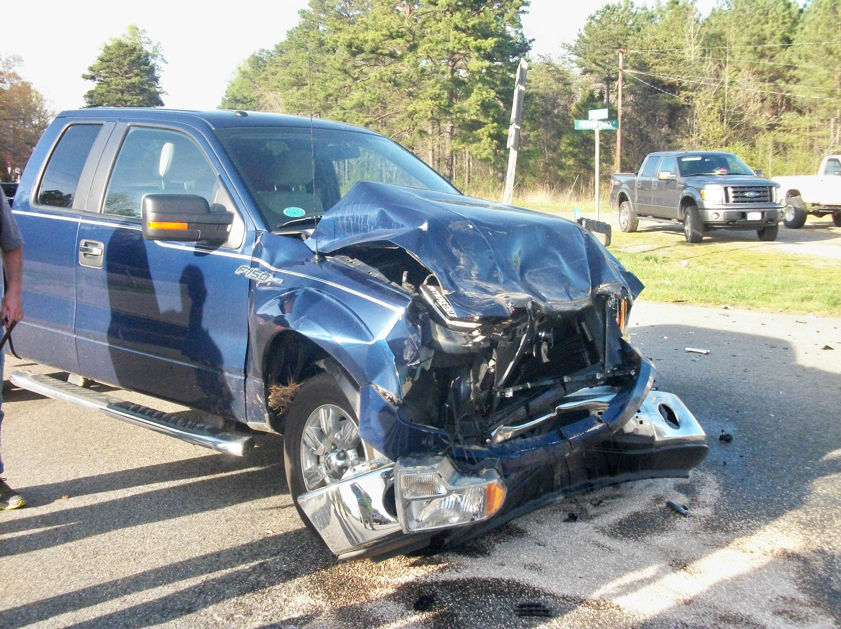
Scenarios
SrA George crashed his GOV at work.
Previous LOCARs
RIC for substandard work performance

Slide 20
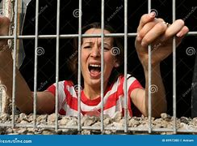
Scenarios
Amn Shepard forgot her RAB and was detained by Security Forces.
Previous LOCARs
1 LOC for disrespecting an NCO
1 LOA for PT failures

Slide 21
Scenarios
The shirt called to let you know that A1C Pain left the bar last night without paying his tab.
Previous LOCARs
1 LOC for being late to work.

Slide 22
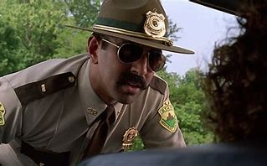
Scenarios
AB Snuffy came through the gate past curfew hours.
Previous LOCARs
None

Slide 23
QUESTIONS?

